Slide 1

MoneyTrail App
Simplify Your Finances and Budget
Mayesha Maliha
ID: 20232091010
Puja Halder
ID: 20232096010
Pranti Das
ID: 20232084010

Slide 2

The Problem
Managing expenses can feel stressful—especially with different income sources. MoneyTrail makes it easy to track everything in one place.

Slide 3

MoneyTrail: Our Solution

Slide 4

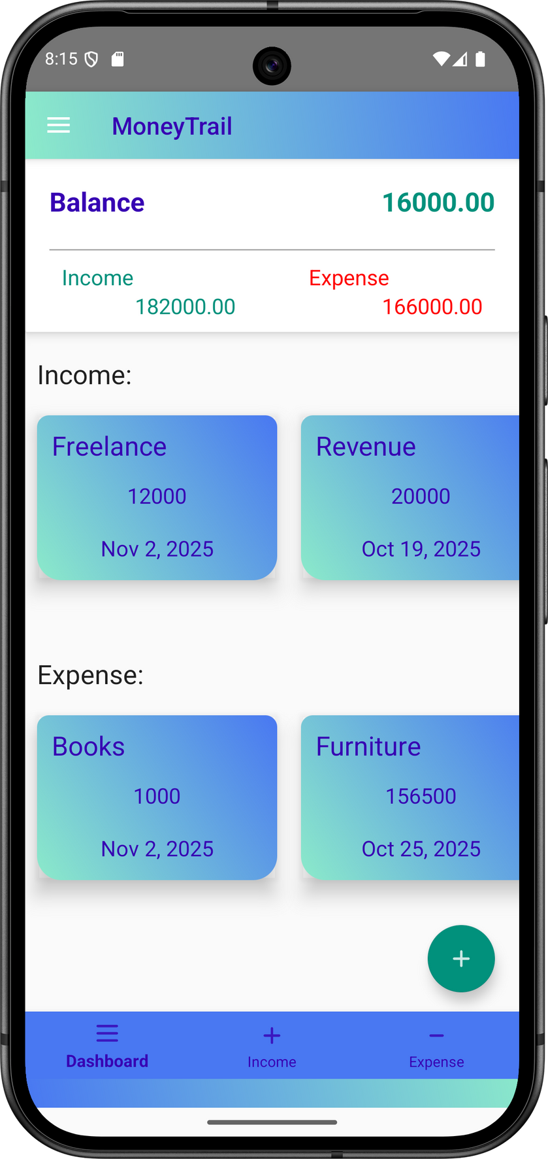
MoneyTrail Overview
A simple finance tracker for everyone
MoneyTrail is designed for users to manage their finances effortlessly. Easily add, update, or delete entries, ensuring a clear overview of your financial situation.

Slide 5
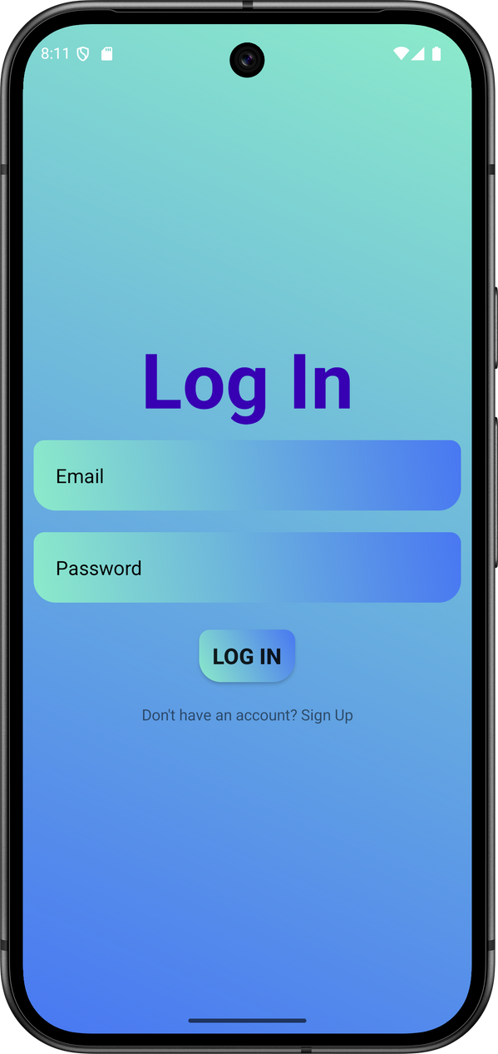
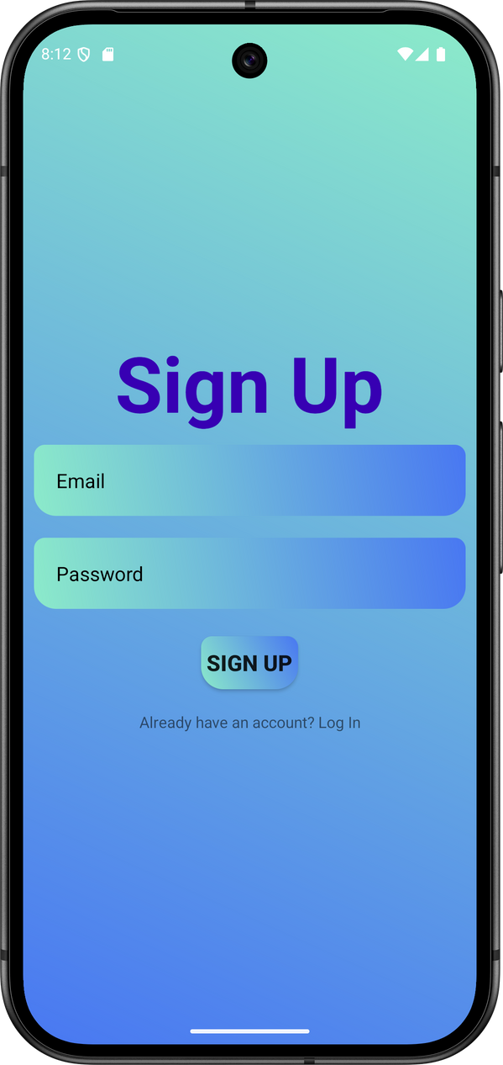

Log In &
Sign Up
Secure access to your personal dashboard
Create your account in seconds

Slide 6
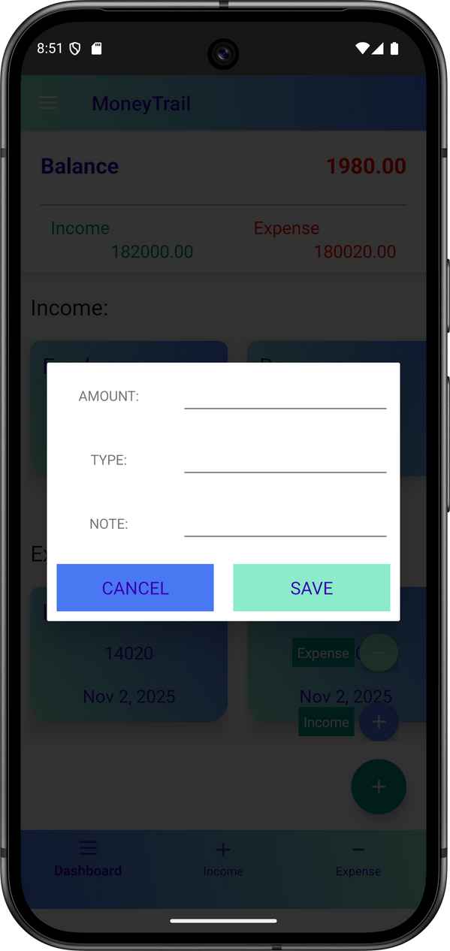
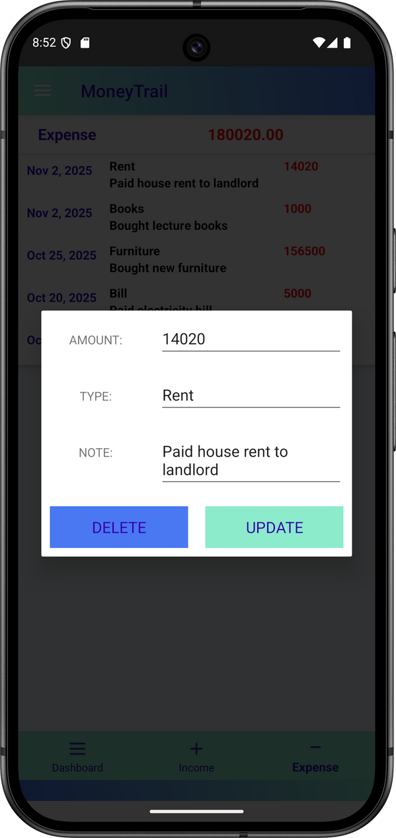
Core Features of MoneyTrail
Add Transactions
Edit Transactions
Easily input income and expenses with details.
Update or remove transaction entries effortlessly.

Slide 7
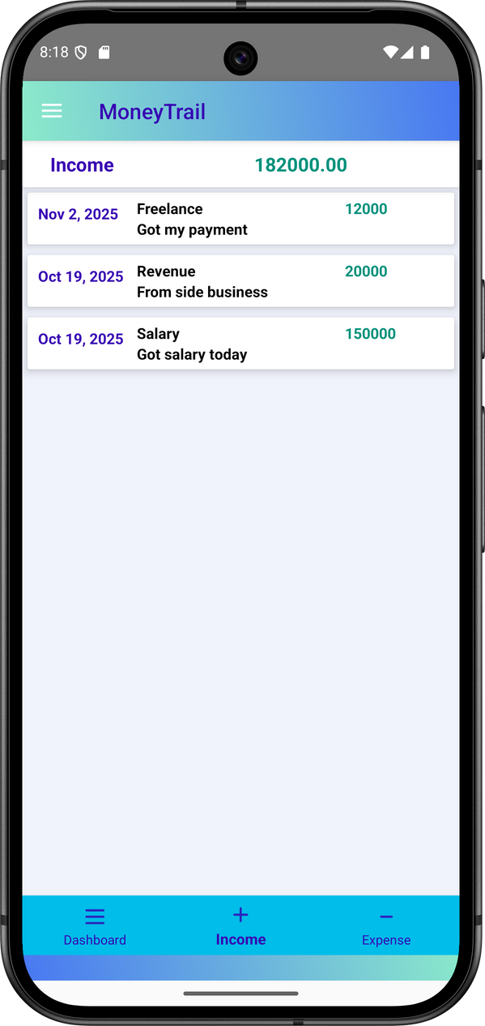
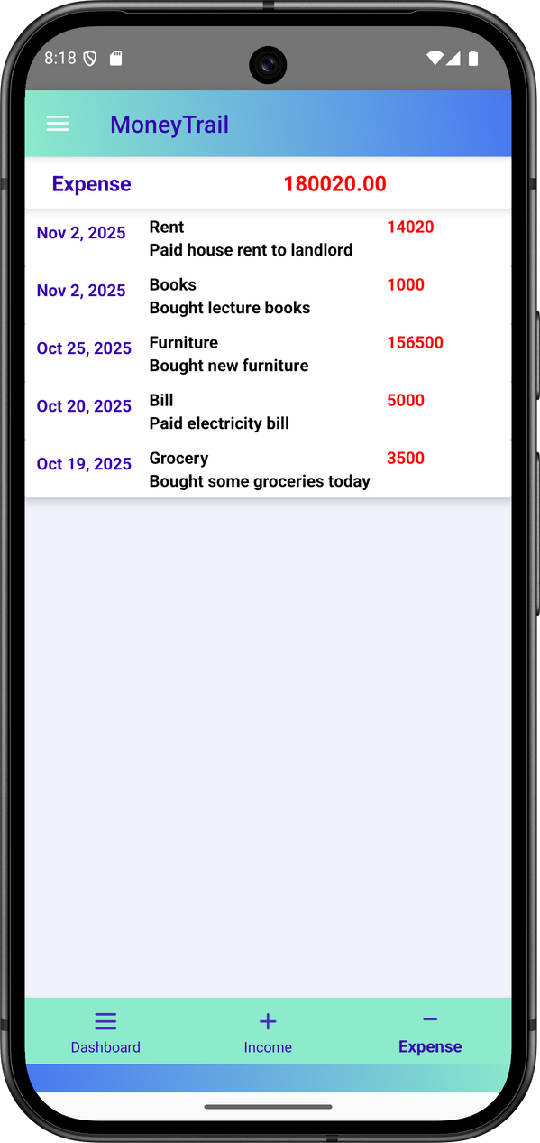
Income & Expense
Screen
Income Screen
Expense Screen
Track all your income sources at one place
See where your money goes—clearly and quickly

Slide 8
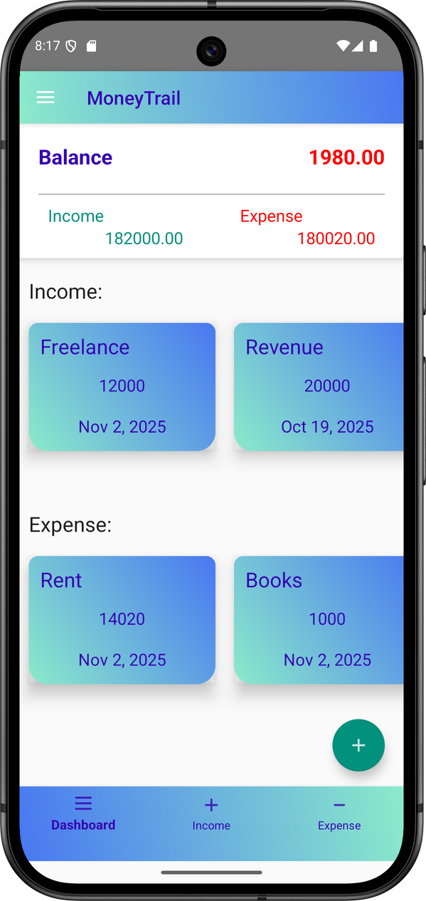
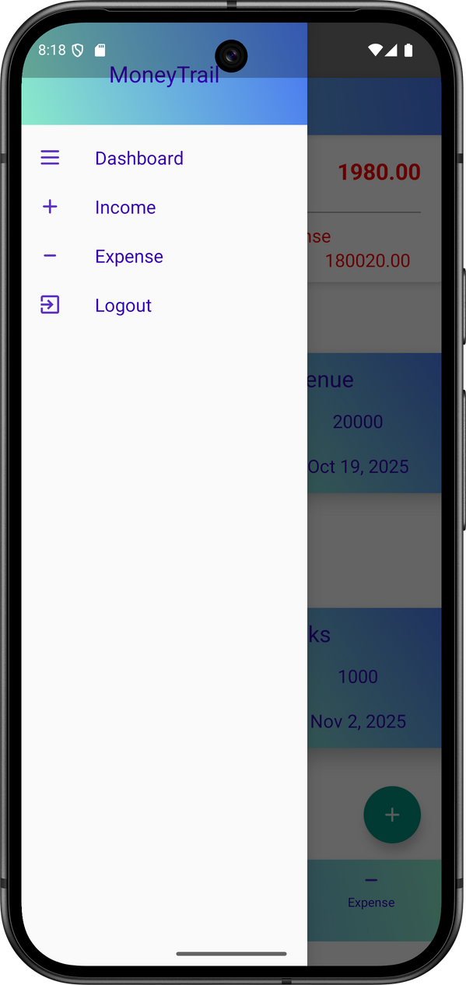
Dashboard Overview: Clear Balance & Easy Navigation
Clear Balance
Easy Navigation
Balance is shown clearly and turns red when it gets too low.
Intuitive design allows for quick access to features.

Slide 9
Key Benefits

Slide 10

Simplicity & Efficiency
Streamlined Tracking with Minimalist Design
Streamlined Tracking
Real-time Balance
MoneyTrail lets users add, edit, or delete income and expense entries, making money management simple and clear.
The app shows your current balance instantly—so you can focus on smart spending.

Slide 11
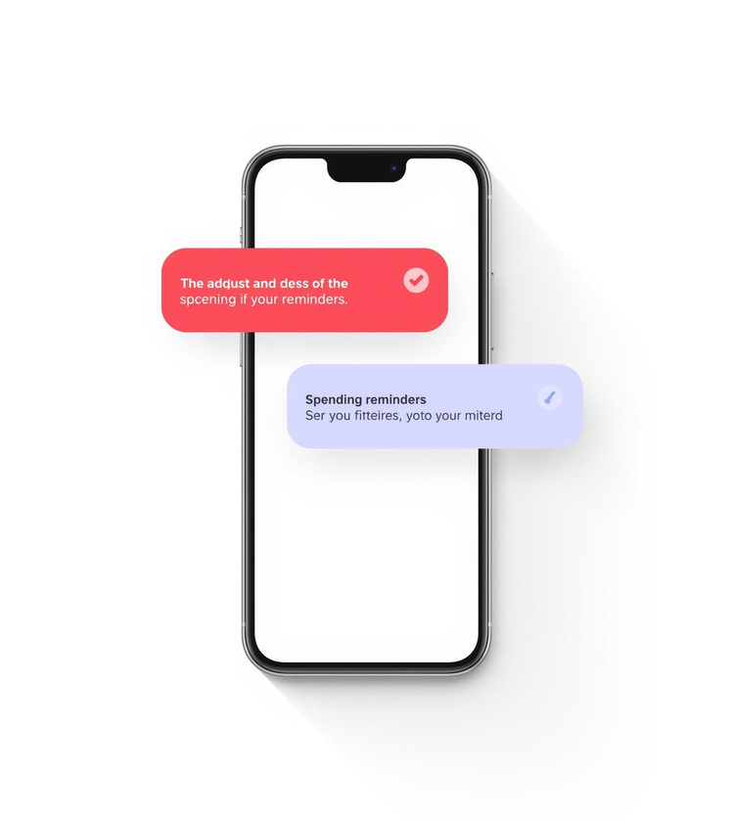
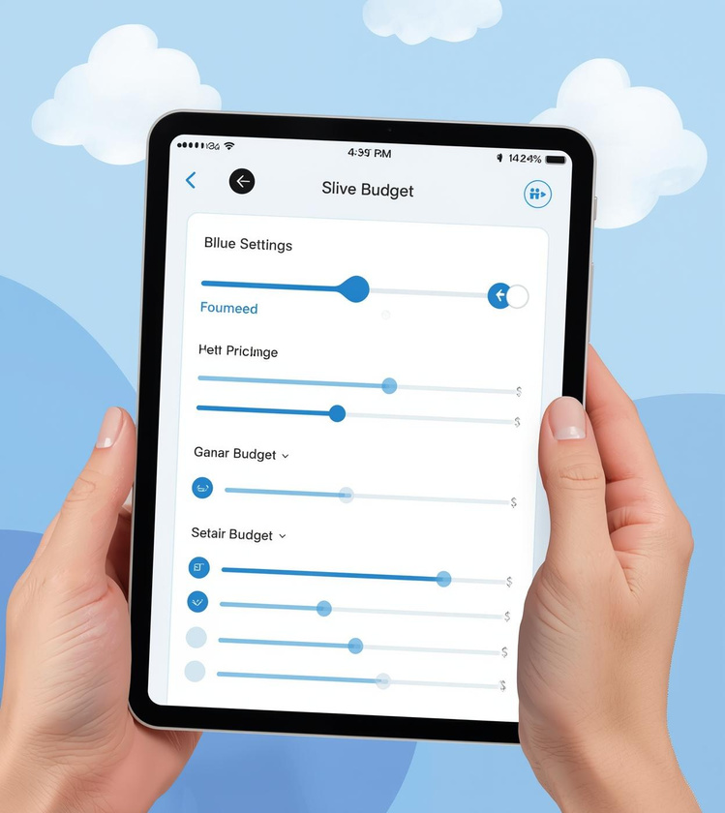
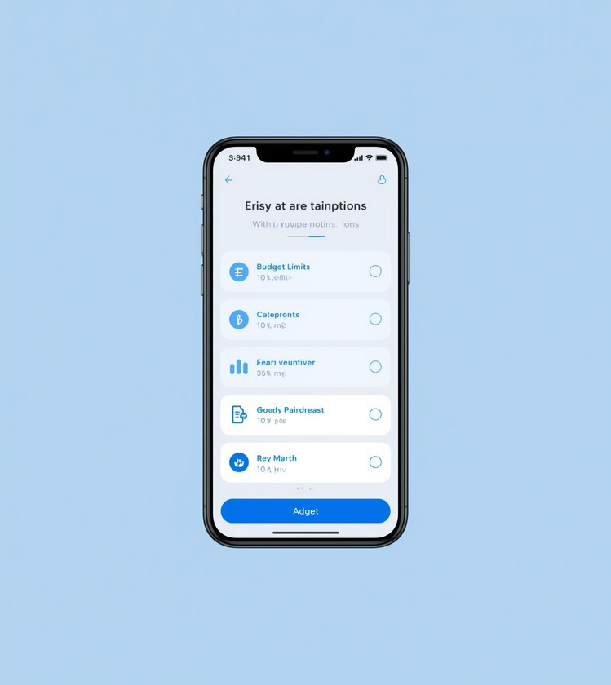
Future Enhancements
Alerts
Budgeting
Visual insights
Get timely notifications for your spending
Easily set and adjust your budget
Understand spending patterns through engaging graphs

Slide 12
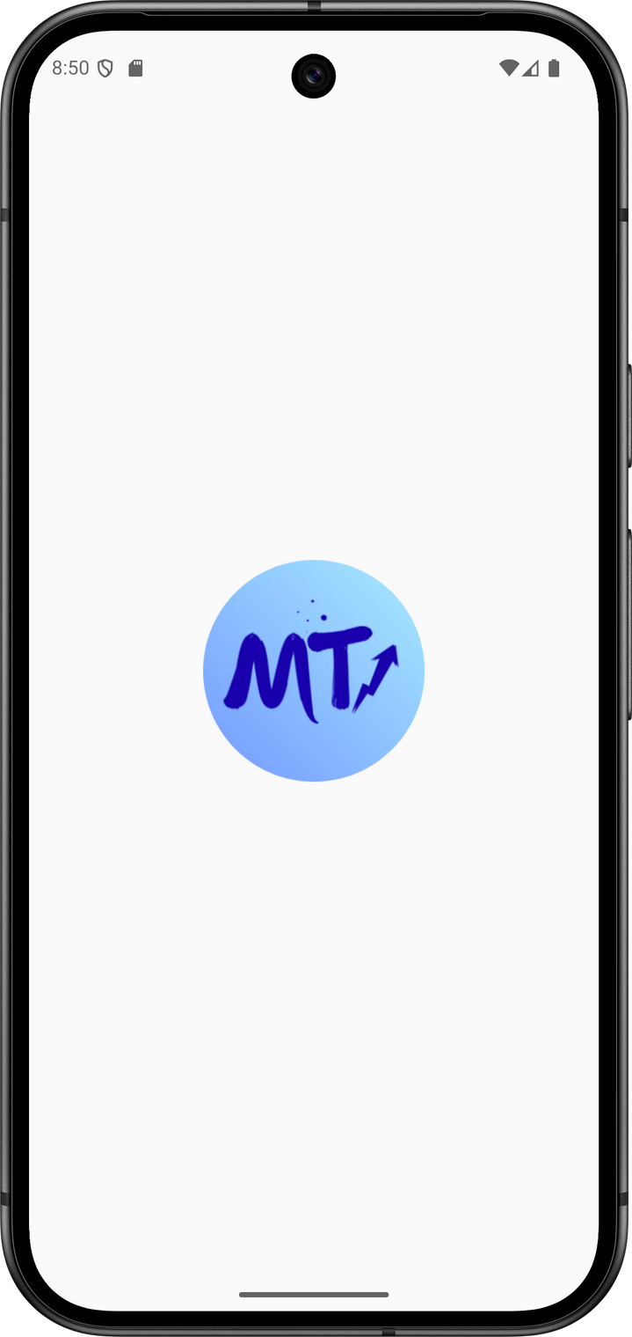
Get Started
Simplify your financial tracking today

Slide 13
Thank You
For Your Attention

